Slide 1
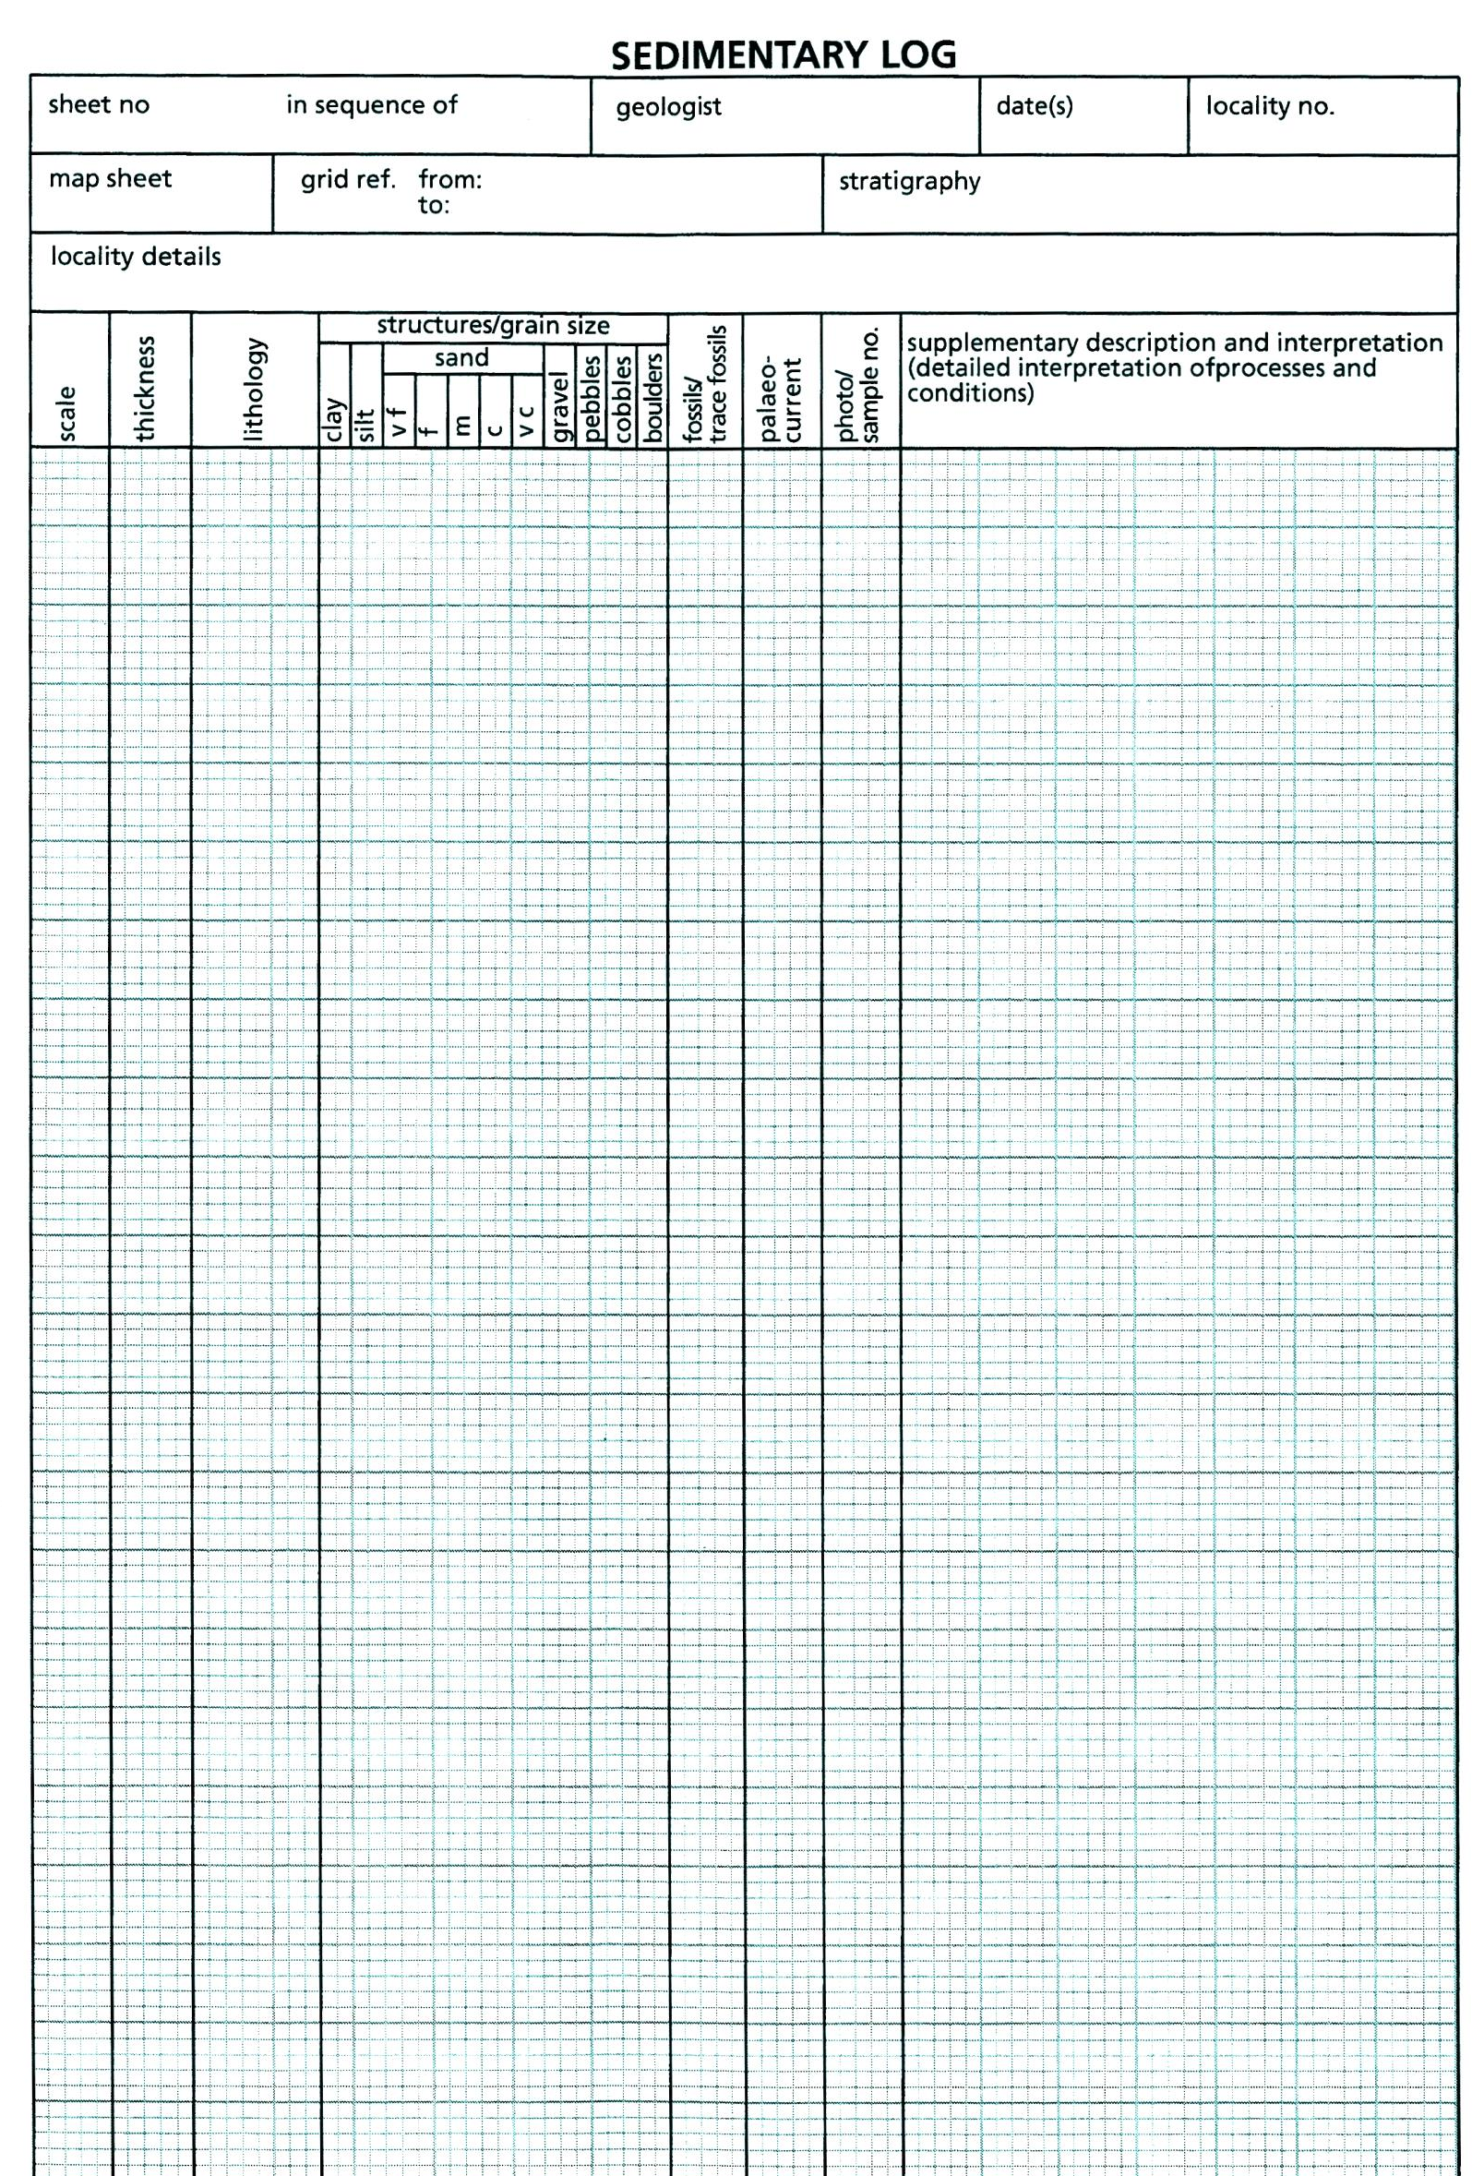
unit
granules
Supplementary description: do not repeat information shown graphically.
Interpretation: include detailed interpretation of processes & conditions for each unit
A key is essential

